Slide 1
GROUP PROJECT
Preliminary Presentation
IS 2102
GROUP IS_10

Slide 2
INNOVIEW
PRESENTING TEAM
SUPERVISOR : MR. RANGANA JAYASANKA
MENTOR : MS. HAMSAVASANI

Slide 3

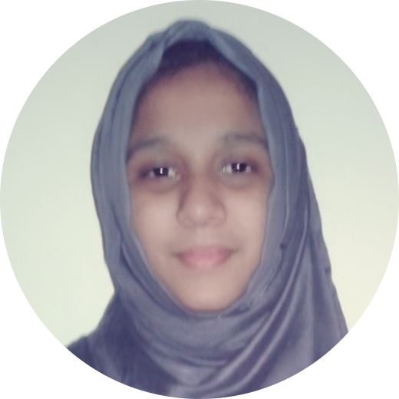


TEAM MEMBERS
H. A. P. C. J. JAYATHILAKA
M. S. MUSHTAQ
H. B. P. HATHURUSINGHE
K. D. H. CHAMIKA
Notes:
You can safely remove this slide. This slide design was provided by SlideModel.com – You can download more templates, shapes and elements for PowerPoint from http://slidemodel.com/

Slide 4

STUDENT MANAGEMENT SYSTEM
SOUTHERN EDUCATIONAL INSTITUTE
Phone:
+94 91 2242 189
Address:
Wimalasurendra Mawatha,
Galle 80000,
Sri Lanka

Slide 5
Project Introduction
Creating a Student Management System for “Southern Educational Institute”.
This system will manage all the functionalities required by the client.

Slide 6
PROBLEM DEFINITION

Slide 7
PROBLEMS
Students don’t make payments in time
Difficult to maintain student records manually
Parents need to track student attendance and educational progress
Difficult to manage staff manually
Hall management done manually is time consuming
Distributing printed material to students is costly
No means of keeping track and analysing student progress

Slide 8
SOLUTIONS
Class admission checking by a barcode scanner
Create a computer based system to maintain details of students and staff
A computer based system to record of all payments done by students
Create a system to keep parents notified via text messages
Maintain a system for staff management and hall management
Maintain an Online Student Management System to post educational material and analyse students’ progress

Slide 9
SCOPE

Slide 10
Our goal
Enhancing education in an environment that encourages accountability,
relevance and retention of the information gathered.

Slide 11
OBJECTIVES
Re-engineering the business processes using technological solutions
Gaining competitive advantage over similar institutes
Automate the manual system maintained to track student attendance
Maintain an automated system to keep parents notified
Providing a web based platform for teacher-student interactions
Hall management and scheduling classes efficiently to reduce time wastage

Slide 12
DELIVERABLES
A Web Application with,
An attractive user interface.
An ability to manage all the functionalities of the system;
Student’s attendance tracking
Students initial payment tracking
Staff management
Lecture halls availability
Teacher management
Students performance tracker and a messaging system
Student-teacher messaging platform
Notes, tutorials etc uploading
Responsive to Desktops, Tablets and Smartphones

Slide 13
SYSTEM BOUNDARY
In scope
Staff management system
Hall management system
Student attendance maintaining system
Payment management system
System to maintain student and staff data
Automatic notification system to notify parents of student attendance and progress
Online learning management system

Slide 14
STAKEHOLDERS

Slide 15
Stakeholders
1
Admin
2
Receptionist
3
Students
4
Teachers
5
Parents of the Students

Slide 16
REQUIREMENTS

Slide 17
FUNCTIONAL REQUIREMENTS
ADMIN
Login to the system
Create user login to student/teacher
Should be able to add, edit and delete courses
Should be able to assign teachers to courses
Should be able remove teachers form courses
Should be able to assign students to courses
Should be able to remove students from courses
Should be able to remove/ change courses of students
Delete or change student details
Enter, delete or change staff details
Enter parent details

Slide 18
FUNCTIONAL REQUIREMENTS
RECEPTIONIST
Enter student details
Maintain student payment details
Staff management
Hall management

Slide 19
FUNCTIONAL REQUIREMENTS
Student
Should be able to login to the system
Should be able to view questions and assessments
Should be able to submit questions to answers
Should be able to view and print teacher feedback
Should be able get a detailed analysis of their progress

Slide 20
FUNCTIONAL REQUIREMENTS
TEACHER
Should be able to login to the system
Should be able to post questions and upload assessments
Should be able to grade answers to questions
Should be able to upload grades of assessments

Slide 21
FUNCTIONAL REQUIREMENTS
PARENT
Receive a text message notification in case the student is absent/late

Slide 22
NON-FUNCTIONAL REQUIREMENTS
SECURITY
Only authorized users can access the data in databases and log-in to online learning management system with the username
and password.
USER-FRIENDLINESS
Simple and clear interface, interactive learning management system

Slide 23
NON-FUNCTIONAL REQUIREMENTS
PORTABILITY
Responsive to smart phones, tablets as well as desktop computers
PERFORMANCE
Responsive to smart phones, tablets as well as desktop computers
ACCURACY AND RELIABILITY
Guaranties accuracy and reliability of records of payments

Slide 24
USE-CASE DIAGRAMS

Slide 25
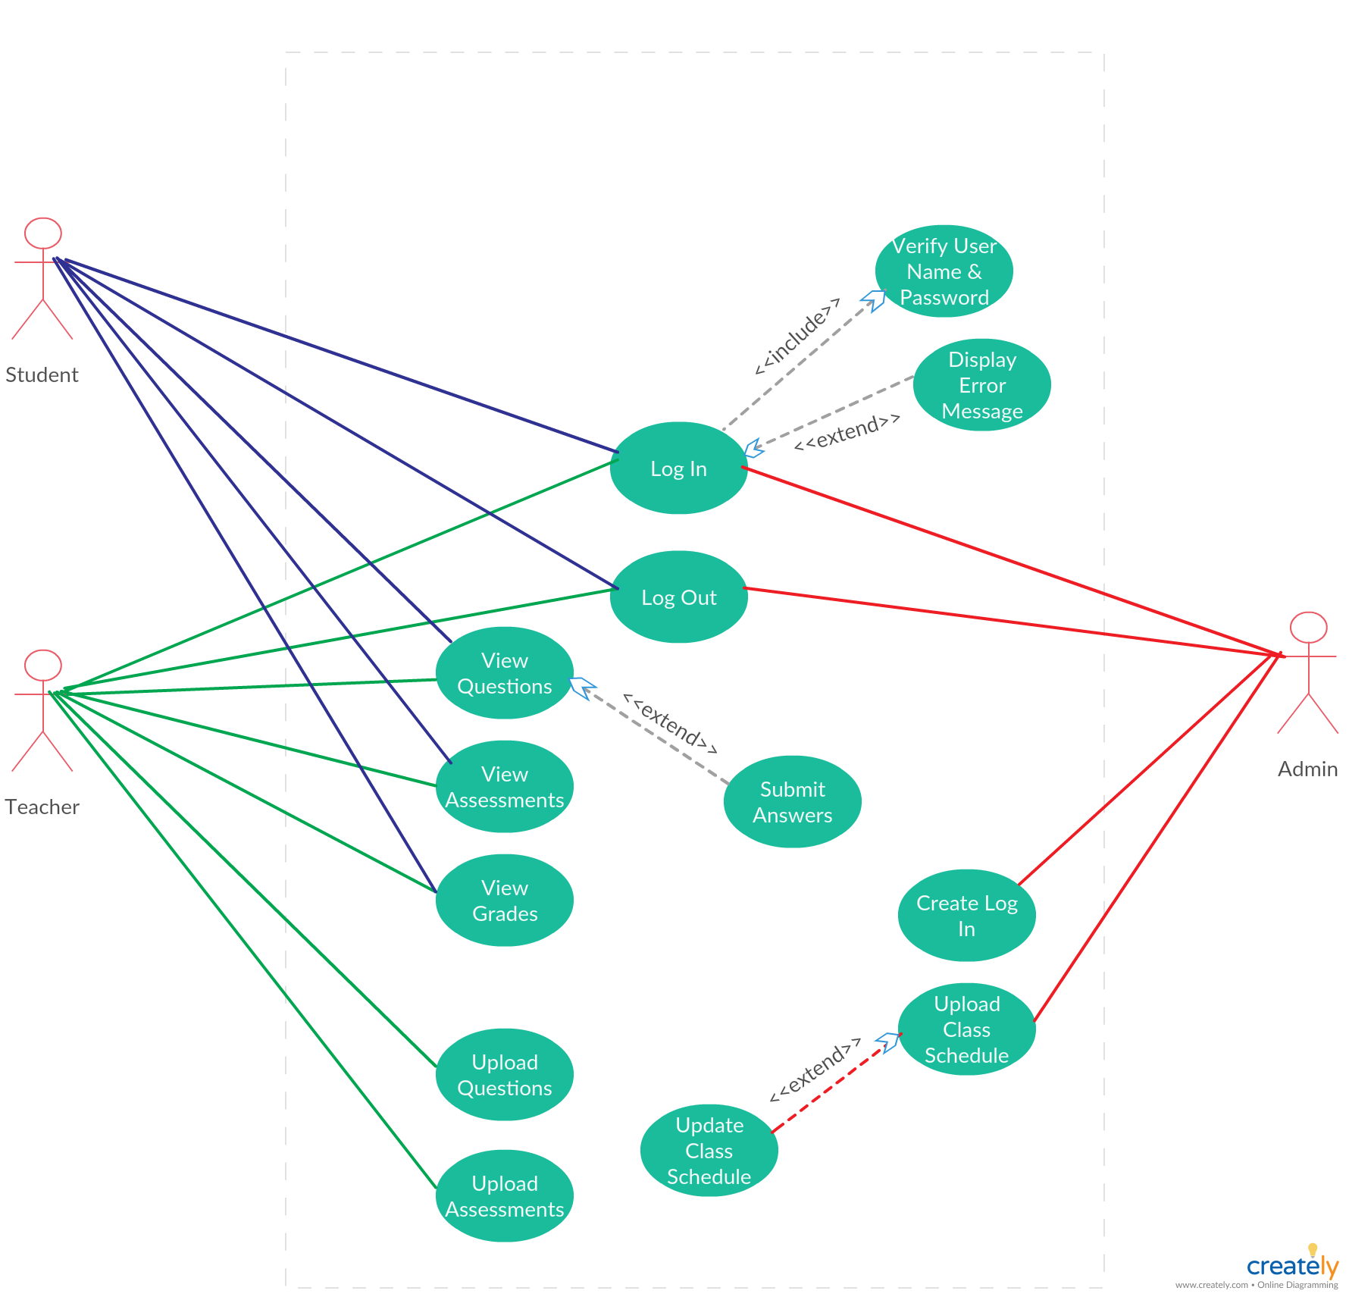
Online Learning Management System

Slide 26
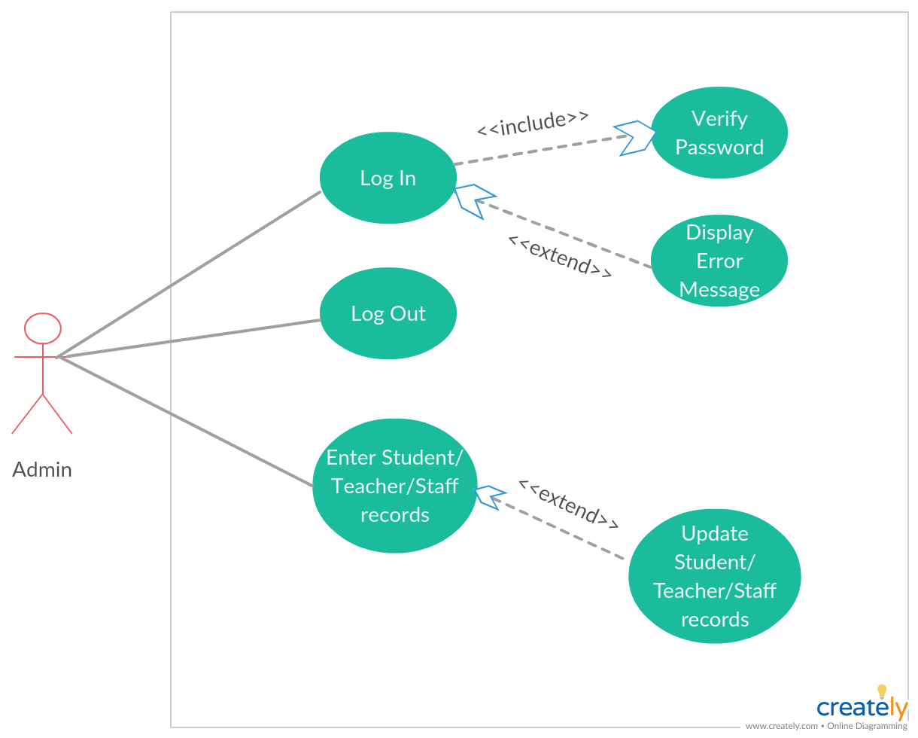
Registration Systems

Slide 27
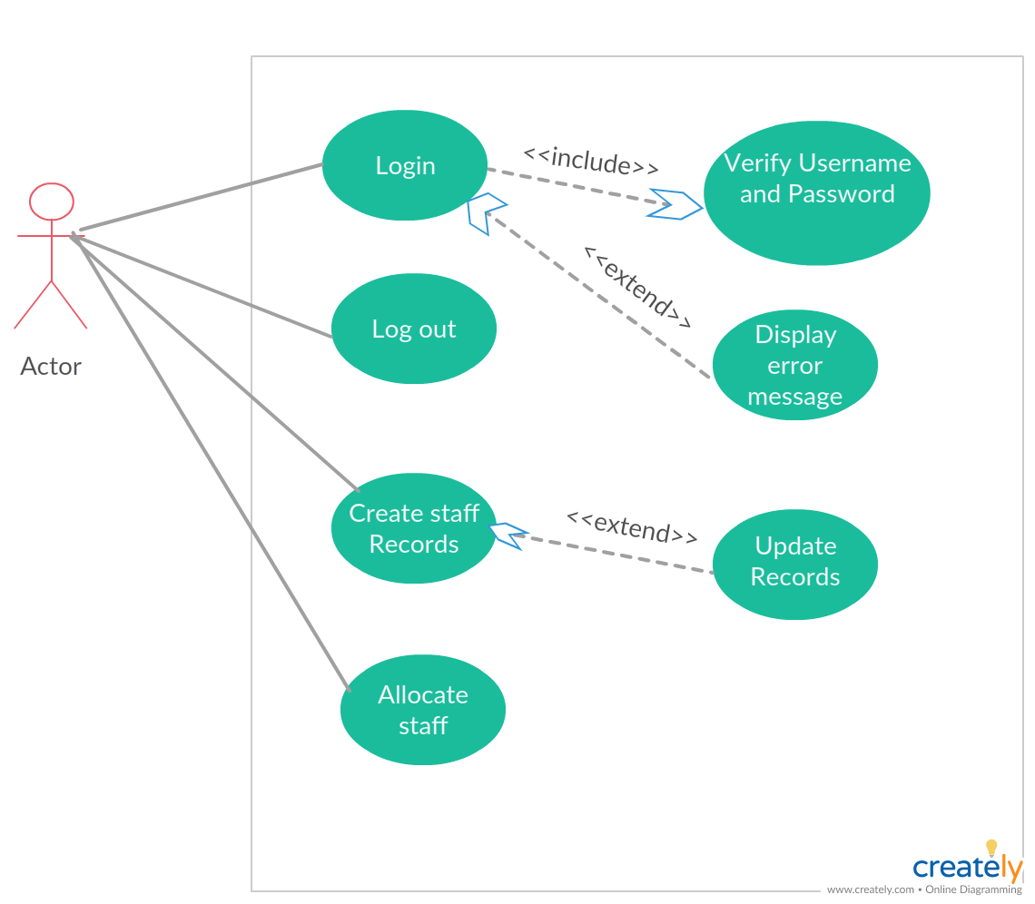
Staff Management System

Slide 28
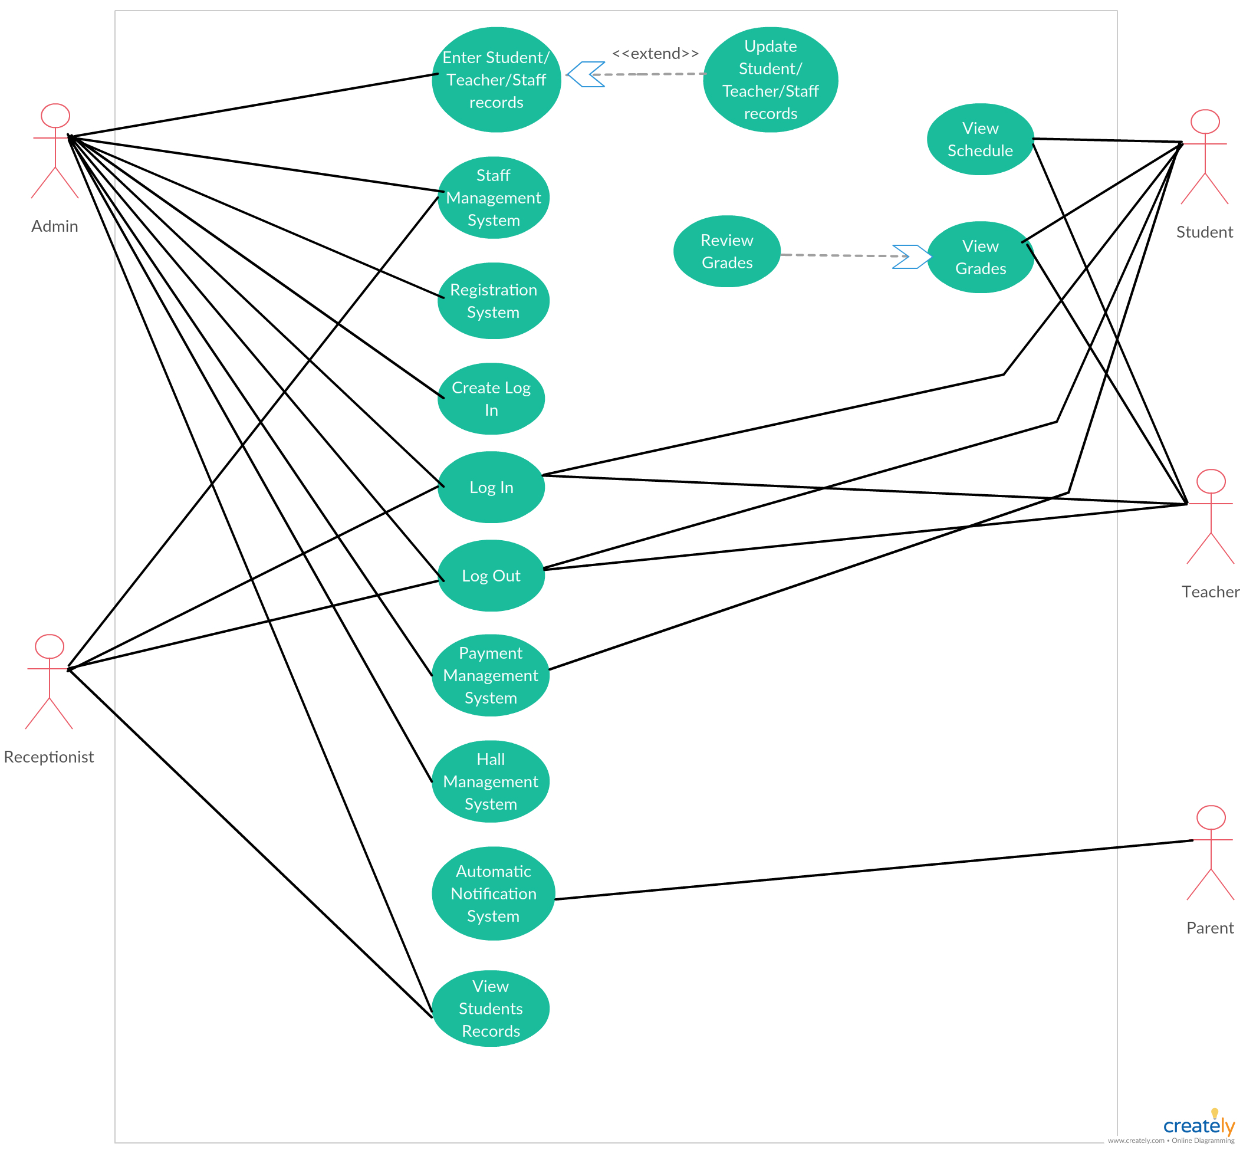
Southern Institute - Galle

Slide 29
FEASIBILITY STUDY

Slide 30
ECONOMIC FEASIBILITY
Our client wants to automate processes previously done manually in order to reduce wastage of money and time
Improve the student and teacher attraction to the institute in order to improve the business
Improve the quality of education provided by the institute to improve the business
Collecting student payments is easier and more reliable
The system is affordable because it is expected to increase the income of the institute

Slide 31
OPERATIONAL FEASIBILITY
Has to train the admin to use the system
User-friendly interface so that basic IT knowledge is enough for the receptionist to use the system. No need to train
Students and teachers with some IT knowledge can browse the web and easily interact with the web application. No need to train

Slide 32
ETHICAL FEASIBILITY
Details of students and teachers are maintained in a secure manner
Payment records of students are maintained in a secure manner

Slide 33




TECHNICAL FEASIBILITY
Our team has substantial knowledge on the technologies hoping to use in the project
Front end
development

Slide 34


TECHNICAL FEASIBILITY
Back end
development

Slide 35
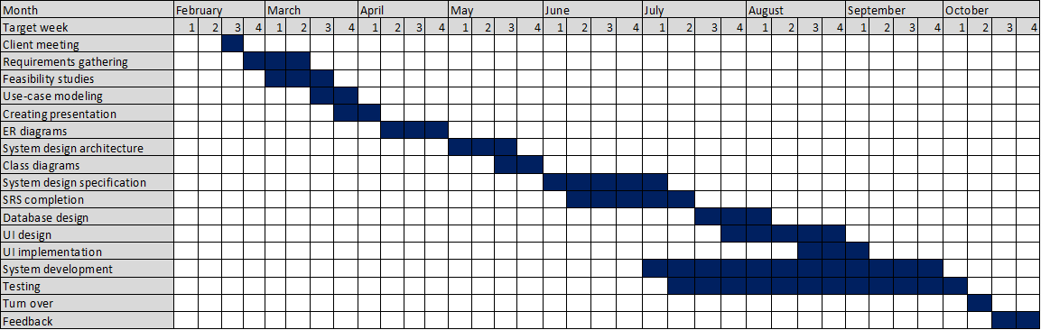
SCHEDULE FEASIBILITY
We are hoping to complete our product in the proposed time schedule

Slide 36
METHODOLOGY
INCREMENTAL METHOD

Slide 37
WHY INCREMENTAL METHOD
Has higher flexibility
Easy to test and debug during a smaller iteration.
Customer can respond to each increment.
Risk management is easy since problems are discovered and managed during each iteration.
Less costly when it comes to change of requirements or scope due to technological advancements.

Slide 38
ARCHITECTURE

Slide 39
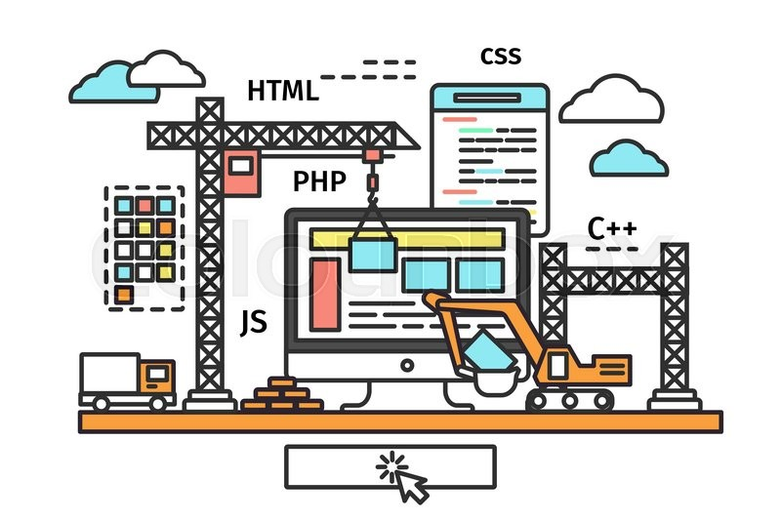
THREE-TIER ARCHITECTURE

Slide 40
HIGH-LEVEL ARCHITECTURE
Admin
Student
Teacher
Receptionist
Parent
Presentation
Tier
Front end
Admin Panel
Front end
Payment management system
Staff Management System
Registration System
Application
Tier
Hall management
System
Online learning management system
Data Tier
Database

Slide 41
LIMITATIONS, CONSTRAINTS AND RISKS

Slide 42
LIMITATIONS AND CONSTRAINTS
RISKS
Time constraint
Reaching students who do not have access to internet

Slide 43
THANK YOU

Slide 44
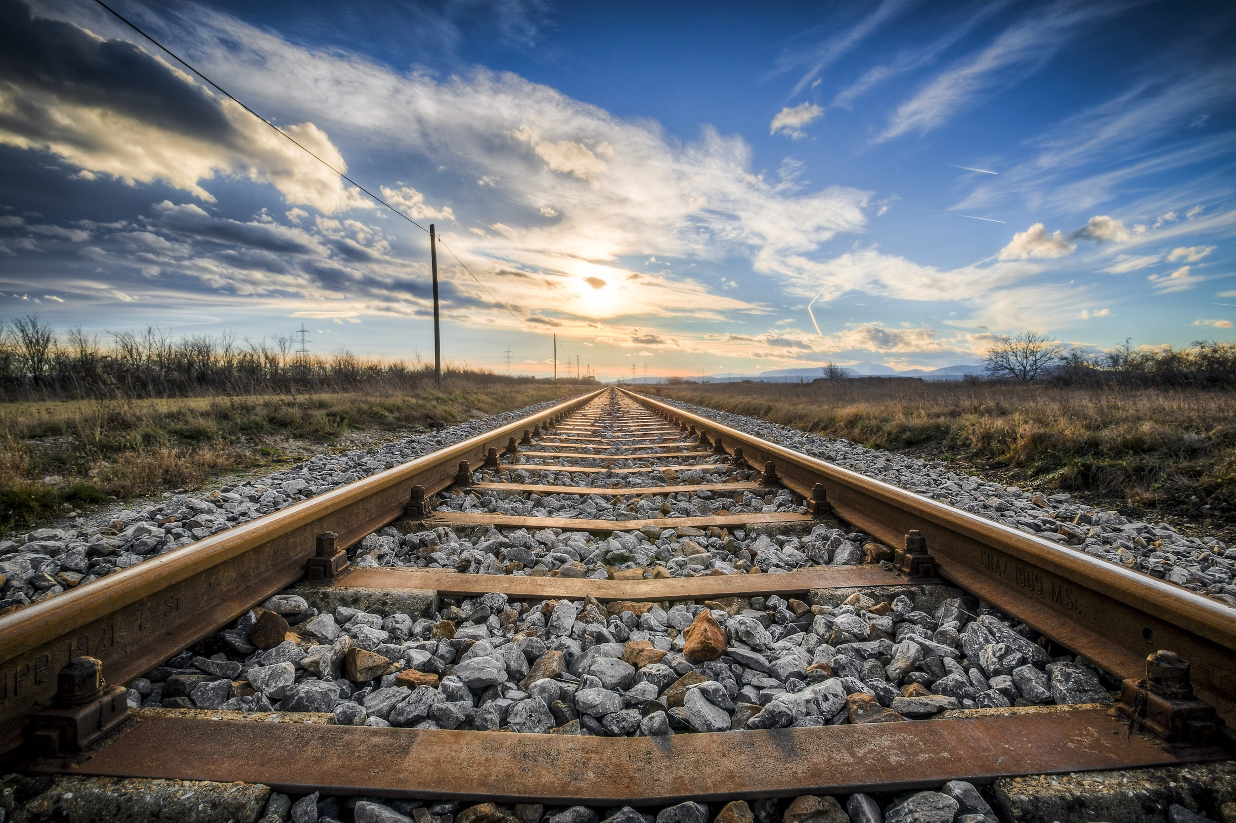
Q&A
Notes:
https://pixabay.com/en/gleise-old-railroad-tracks-seemed-1555348/

